Slide 1
IMP-RCM
Prototype data broker – technical workshop
12th October 2020
(session will be recorded)

Slide 2
Agenda
Introductions
IMP-RCM – scope and purpose: Amanda Hall / XIRCM SG
Workshop – goals and agenda: Pete Johnson / Vivacity Rail Consulting
10:15 The prototype data broker
Design goals
Overview
Demonstration of operation
Relevance for ENRICH
Q & A
11:00-ish <BREAK!>
11:15-ish Data broker - technical
Physical structure
Code elements
Docker + Docker Compose
Python
PostgreSQL
Powershell scripts
Jenkins scripts
Getting hold of the broker and running it
12:00 Test data generator
Data setup
Batch mode operation
Live mode operation
12:30 Wrap-up

Slide 3
Introduction
The IMP-RCM project in context – Amanda Hall
History and background – XIRCM SG, T1010
IMP-RCM goals
Demonstration data broker
Relationship to ENRICH
This workshop – goals – Pete Johnson
Describe the principles explored in the IMP-RCM demo data broker
Show the broker working
Explain code samples
Introduce the online resources

Slide 4
IMP-RCM scope and purpose
T1010
IMP-RCM – Pilot Project
Tasks
Outputs
04 - business case tool
Work out business case
Guidance documentation
Prototype broker
02 - commercial / legal principles
Help parties to reach agreement
Advice on production broker
01 - technical architecture
Build prototype broker
Demonstration to industry

Slide 5
Prototype broker - design goals
Prepare a standard schema for UGMS data in- and out-bound, based on T1010 principles
Show that the schema is easy to use for data providers
Prepare sample inbound data adapter with code samples and guidance
Python version prepared. Other languages would be very similar
Show that the schema is easy to use for data consumers
Prepare sample outbound data adapters with code samples
Show that the broker approach brings benefits
Simple connection for data providers and consumers
Supports application of standards

Slide 6
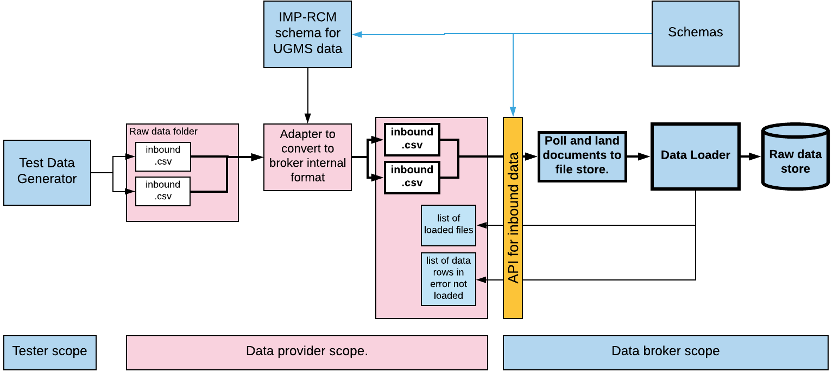
The prototype data broker – inbound side
Notes:
This covers the data inbound elements of the broker. The key things are:
Use of schemas to define data standards for adapter and API
Demarcation of scope – blue = data broker; pink = data provider
Standard API for loading data. Data providers need to adapt their data to the correct format defined by the API
Notification of validation errors.

Slide 7
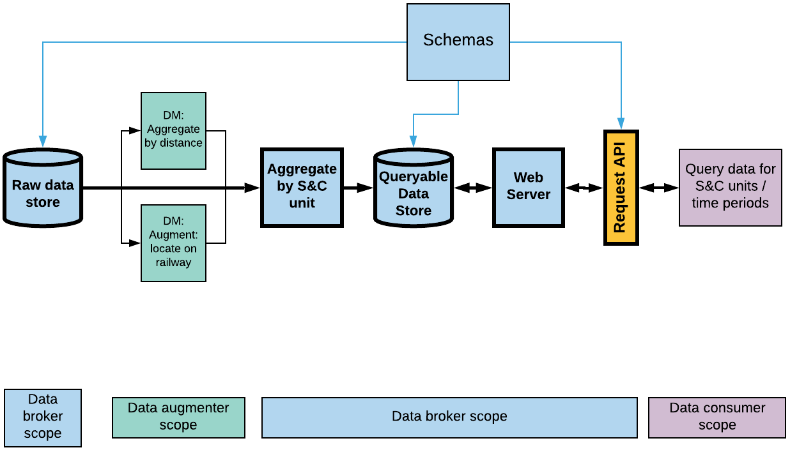
The prototype data broker – outbound side
Notes:
Key things here are:
- Use of schemas to define data formats for data in store and the outbound API.
Scope demarcation – broker, data augmenter, data consumer
API for requesting and receiving data: standard, simple to use

Slide 8
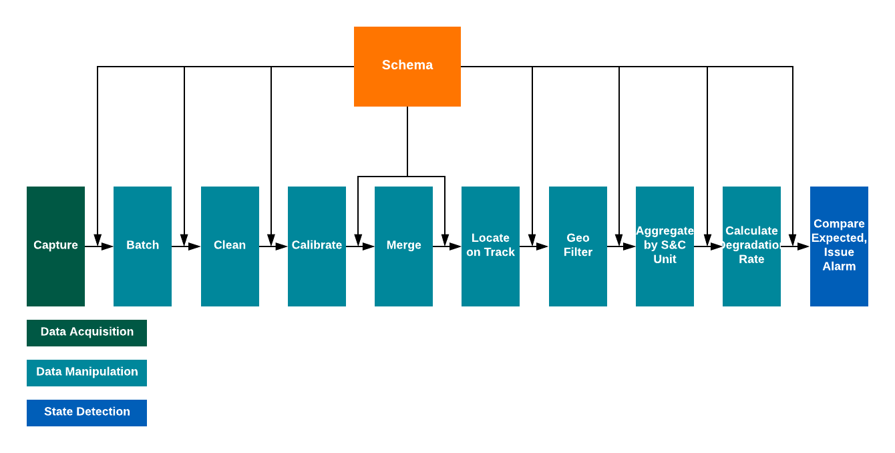
The prototype data broker – processing pipeline
Notes:
This shows the pipeline used in the

Slide 9
The schemas
“Canonical data model”
Master schema
Names, descriptions, validations, notes
Input schemas
Internal schemas
Output schemas
CSV
Database tables
CSV
XML
Message stores
XML
JSON
JSON
Web API

Slide 10
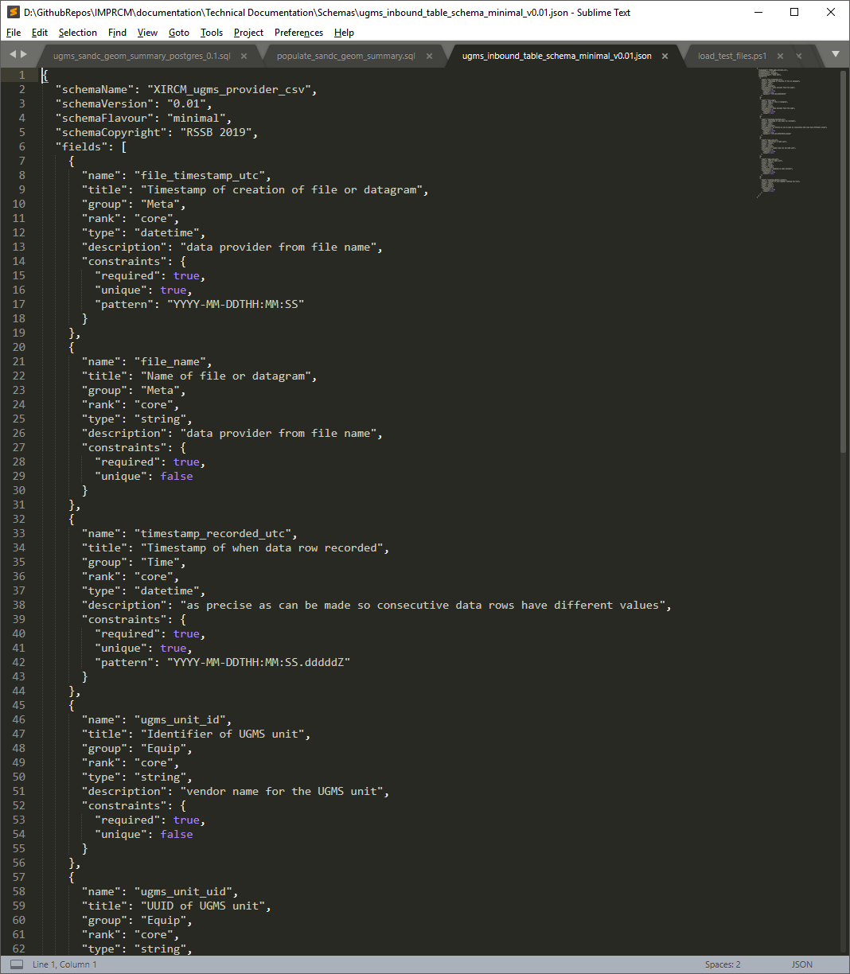
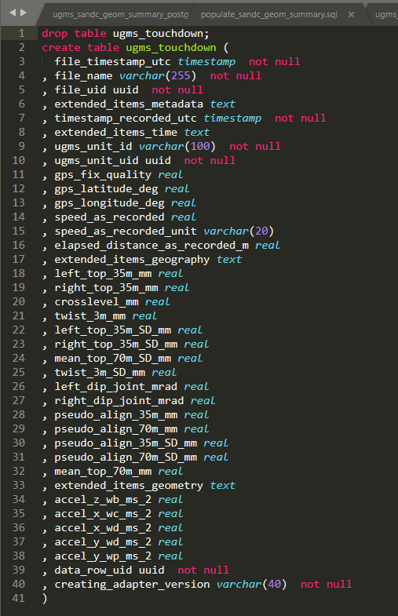
Same schema, different representations
UUIDs for all the things
Table Schema for CSV
PostgreSQL table definition
Standard representations (ISO)
Readable names, engineering units
Extension points, not part of schema

Slide 11
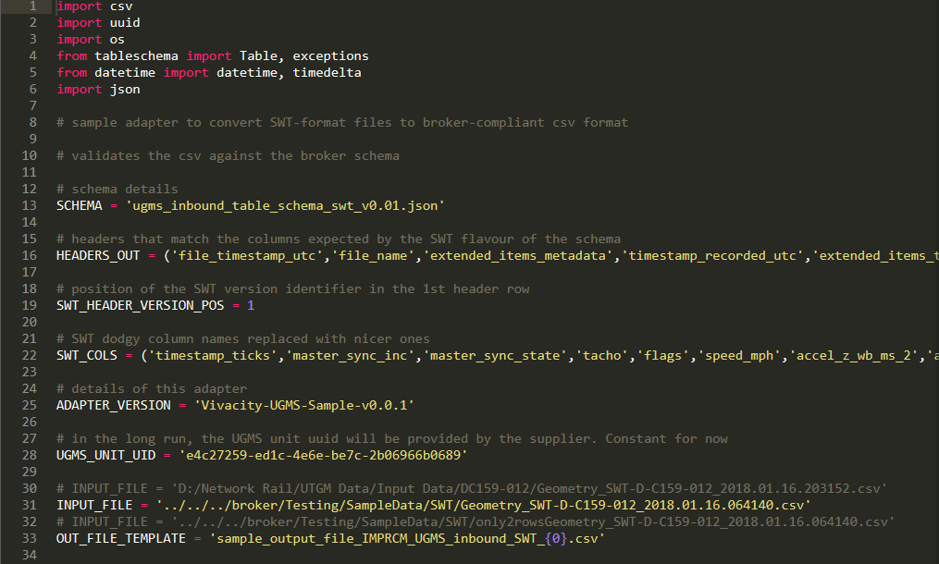
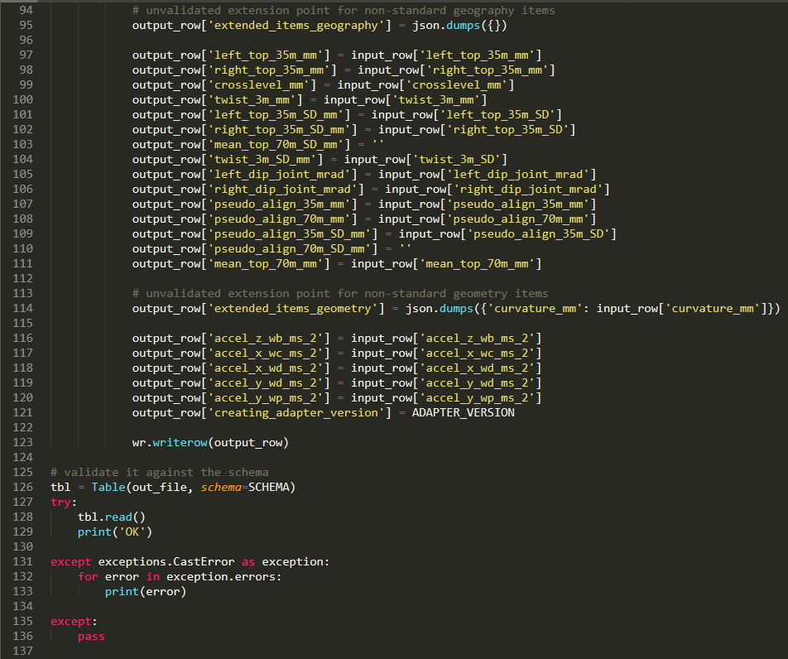
Inbound data adapter
Schema used to validate data
Schema-compliant headers from Excel
Easy to map incoming and schema-compliant outgoing data items
Non-validated non-schema extended items wrapped as JSON
Validate the output file against the schema before sending to broker

Slide 12
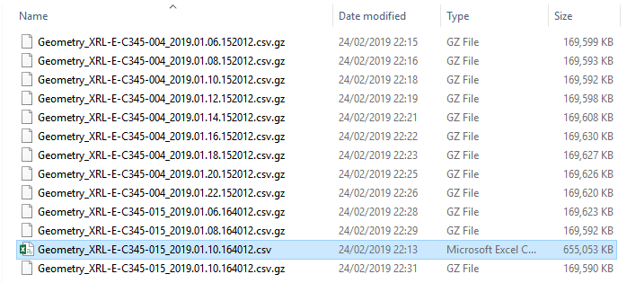
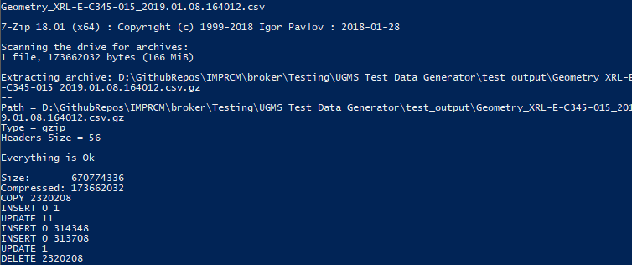
Sample data run
Test data setup
London to Reading and back
2 UGMS units
Each working 6 trains in a day
6 days of operation at 2-day intervals
Simulated degradation / repair / degradation of S&C units
Test data
12 csv files, each about 650Mb in size, holding 1 unit’s 1 day’s data
Total 28 million rows of data at 0.2m grain
Each file takes
2 minutes to create
1 minute to compress
3 minutes to load and process
(so far no optimisation / tuning of loading process)

Slide 13
Demonstration of the data broker
Start up the broker
Drop some (simulated) UGMS data files into an input folder
Watch as the broker loads, processes and archives the files
Show the data present via the outbound API
Extract the data into an Excel spreadsheet using the API

Slide 14
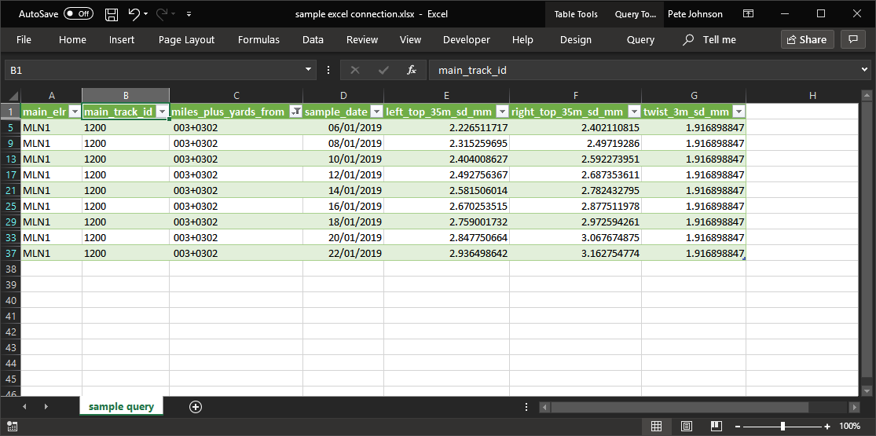
Result – summary by S&C unit

Slide 15
Relevance to ENRICH
Use of API to request data
Uses standard methods and schemas
Well-documented
Easy to use
Use of shared schemas
Applicable at input side, output side and internally
Readily available for end users to refer to
Standard data formats
Open standards
Clear naming of data items
Easy to use with downstream tools
Containerisation
Easy to develop
S

Slide 16
Break
Re-convene in 15 minutes …

Slide 17
Broker - physical structure and code
Overview
Input adapters
Python code to map from vendor to broker .csv format for UGMS data
Scripts to load and touch down data into broker data store
Processing pipeline
Python code and SQL scripts to poll data store and fire processing pipeline on new data
Outbound API server
Python-based web server driven by Swagger API spec
Packaging
Processing, data storage and web server components implemented as Docker containers and managed using Docker Compose
Jenkins scripts to build and run the broker
Github repository with code and instructions
Discussion

Slide 18
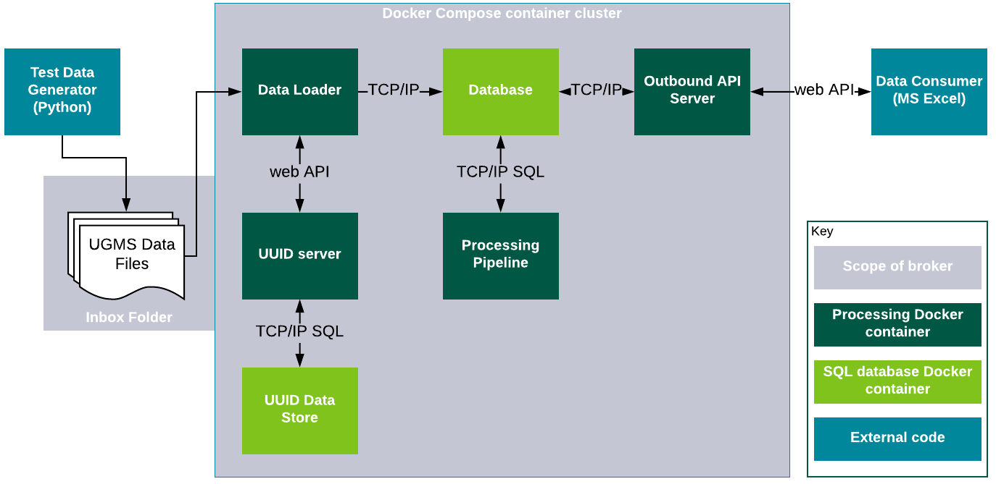
The prototype data broker – physical structure
Notes:
The broker is

Slide 19
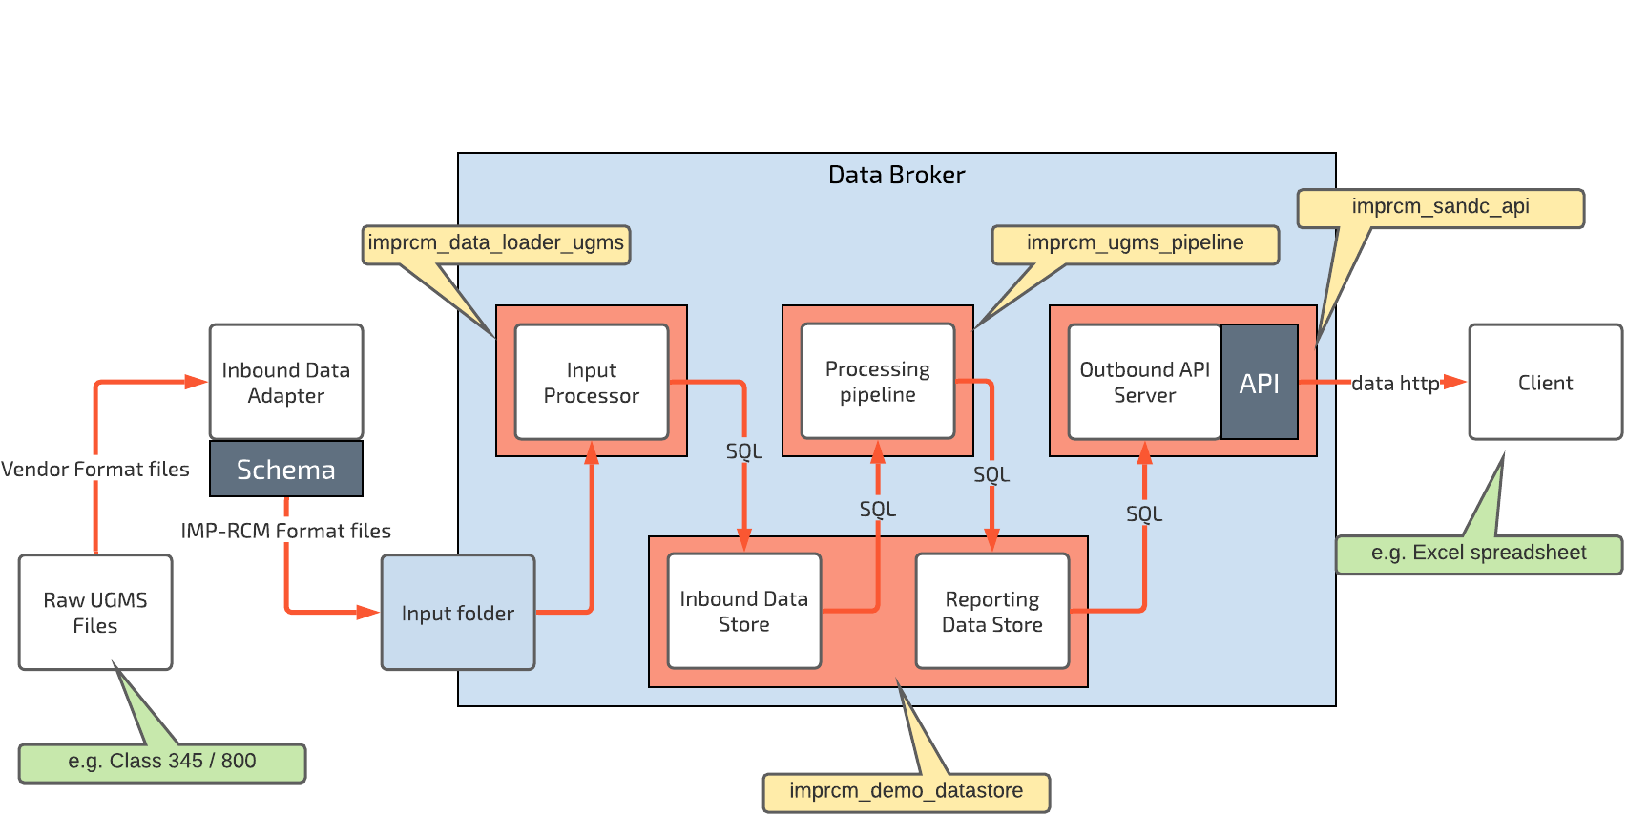
Overview – containers

Slide 20
Input adapters
Examples are in Python 3
Convert from vendor-specific UGMS .csv format to a standard IMP-RCM .csv format
SWT class 159 UGMS
GWR class 800 Hitachi UGMS
(easy to adapt to other vendor files)
Use elements from the schemas spreadsheet for consistency
Can validate the generated file against the “table schema” schema
Can generate output files or pipe the output directly into another program

Slide 21
Processing pipeline
Python script
Polls the database to look for newly-loaded files
Runs SQL scripts to sync and summarise data

Slide 22
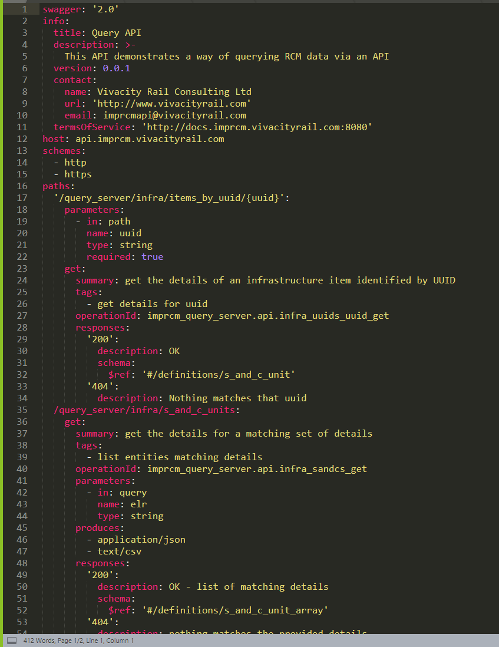
Outbound API
Python web server using Flask and connexion
Code is built from a schema defined in Swagger
The documentation is available alongside the API
Samples (generally) work

